Slide 1
Genetic Programming System
Mohammed Alsaihati
Warsame Bashir
Kholoud Benderaa
Rajesh Gupta
Jayesh Naithani
12/04/2013

Slide 2
Outline
Introduction and Assignment #10 (Kholoud)
Project Description (Mohammed)
Requirements (Mohammed)
Analysis and Design (Rajesh)
Demo (Jayesh)
Metrics and Measurement (Jayesh)
Design Decisions (Warsame)
Testing (Warsame)
Lessons Learned (Rajesh)
Conclusion (All)

Slide 3
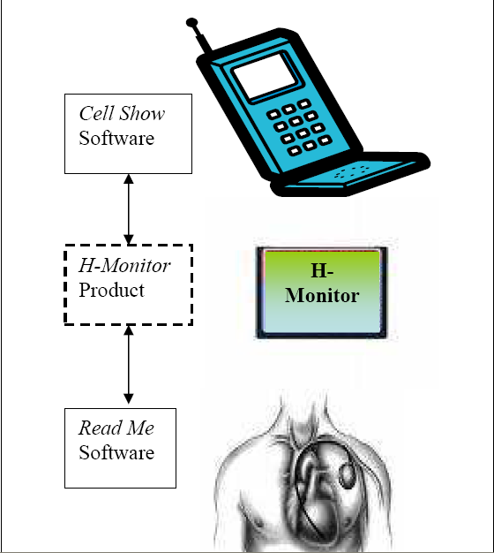
Connection Verification Test
Treat H-Monitor as a Black Box
To verify connection between H-Monitor Product to correct Read Me Software specified by the Serial #
Test Procedure:
Send connection request to H-Monitor Product to connect to Read Me Software with Serial #
Check Read Me Software with Serial # for connection request from H-Monitor Product

Slide 4
Data Integrity Test
To verify integrity of raw data received by Cell Show Software from Read Me Software via H-Monitor Product
Test Procedure:
Input raw compressed data with CRC checksum into H-Monitor Product
Verify CRC checksum and raw compressed data in output from H-Monitor Product

Slide 5
Outline
Introduction and Assignment #10 (Kholoud)
Project Description (Mohammed)
Requirements (Mohammed)
Analysis and Design (Rajesh)
Demo (Jayesh)
Metrics and Measurement (Jayesh)
Design Decisions (Warsame)
Testing (Warsame)
Lessons Learned (Rajesh)
Conclusion (All)

Slide 6
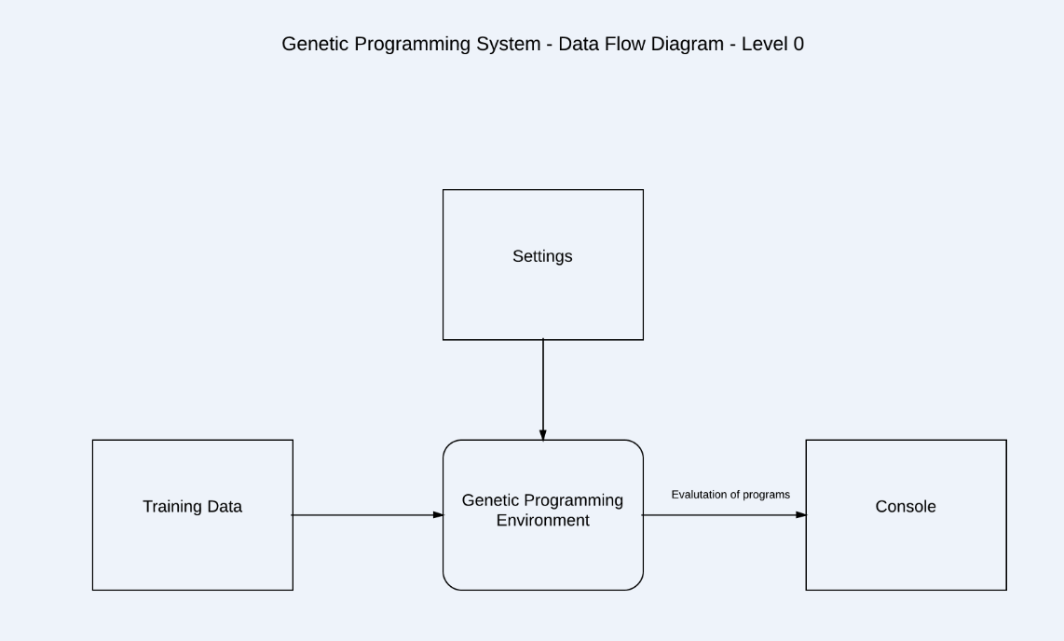
Project Description
To design and build a Genetic Programming System
To build the system using current Software Engineering practices
Notes:
The GP system uses a genetic algorithm to initialize, evaluate fitness, select, crossover, mutate, update and returns the highest fitness of each function.

Slide 7
Project Requirement
Find optimal or near optimal solution for target function
y = ( -3X² + 7 ) / 2
Use genetic programming concepts
15 Minute Limitation

Slide 8
Project Collaboration
Weekly on-campus and online team meetings
Use of online tools
Google Docs
GitHub
https://github.com/jnaithani/genetic-programming
Team Viewer
Skype
LucidChart
Google IO
Microsoft Office
Development Tools
Eclipse
IntelliJ

Slide 9
Outline
Introduction and Assignment #10 (Kholoud)
Project Description (Mohammed)
Requirements (Mohammed)
Analysis and Design (Rajesh)
Demo (Jayesh)
Metrics and Measurement (Jayesh)
Design Decisions (Warsame)
Testing (Warsame)
Lessons Learned (Rajesh)
Conclusion (All)

Slide 10
Analysis
Project plan
Requirements capture
Input
Training Data
Settings
Output
Display and Data Capture
Selection, Crossover, Mutation
Time Constraint
Modeling and Preliminary Design
Data Flow Diagrams
Class Diagrams
Interaction Sequence Diagrams
Task Breakdown
Notes:
Project plan
Requirements capture
Input
Training Data
Settings
Output
Display and Data Capture
Selection, Crossover, Mutation
Time Constraint
Modeling and Preliminary Design
Data Flow Diagrams
Class Diagrams
Interaction Sequence Diagrams
Task Breakdown

Slide 11
Approach
Object-Oriented
 | Structured | Object-Oriented
Methodology | SDLC | Iterative/Incremental
Focus | Processes | Objects
Risk | High | Low
Reuse | Low | High
Maturity | Mature and widespread | Emerging
Suitable for | Well-defined projects with stable user requirements | Risky large projects with changing user requirements

Slide 12
Design
Software Architecture
Java
Object Oriented
Modular Design
Simple User Interface – low priority
Data Structure
Binary Trees and Nodes
Program Data Structures
Training Data
Settings
Functions
Random number generators
Genetic Operators

Slide 13
Outline
Introduction and Assignment #10 (Kholoud)
Project Description (Mohammed)
Requirements (Mohammed)
Analysis and Design (Rajesh)
Demo (Jayesh)
Metrics and Measurement (Jayesh)
Design Decisions (Warsame)
Testing (Warsame)
Lessons Learned (Rajesh)
Conclusion (All)

Slide 14
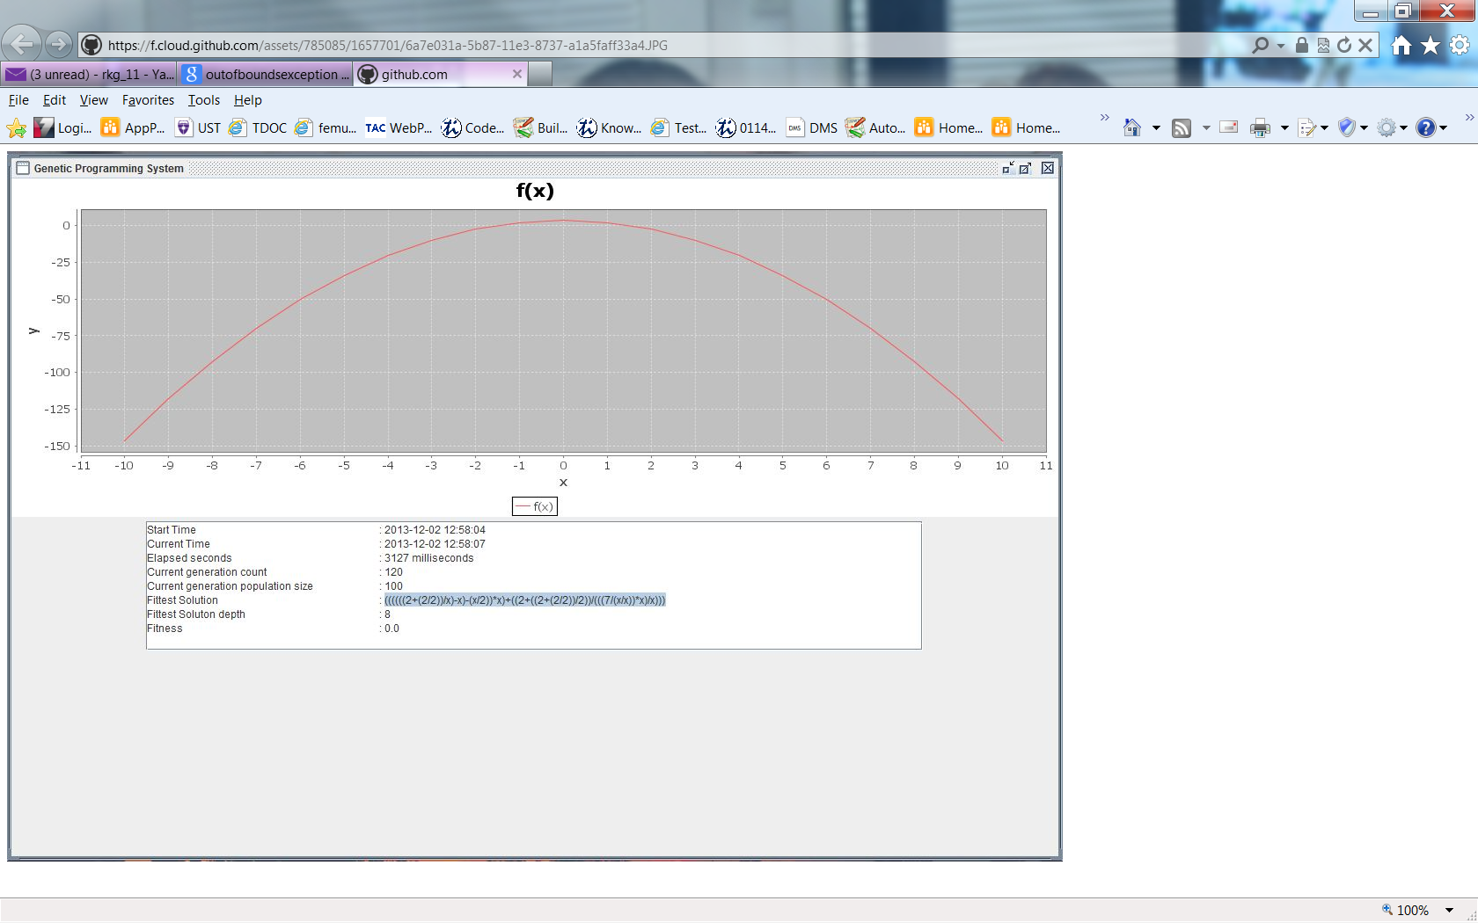
Demonstration
Program Dashboard (using new requirement)

Slide 15
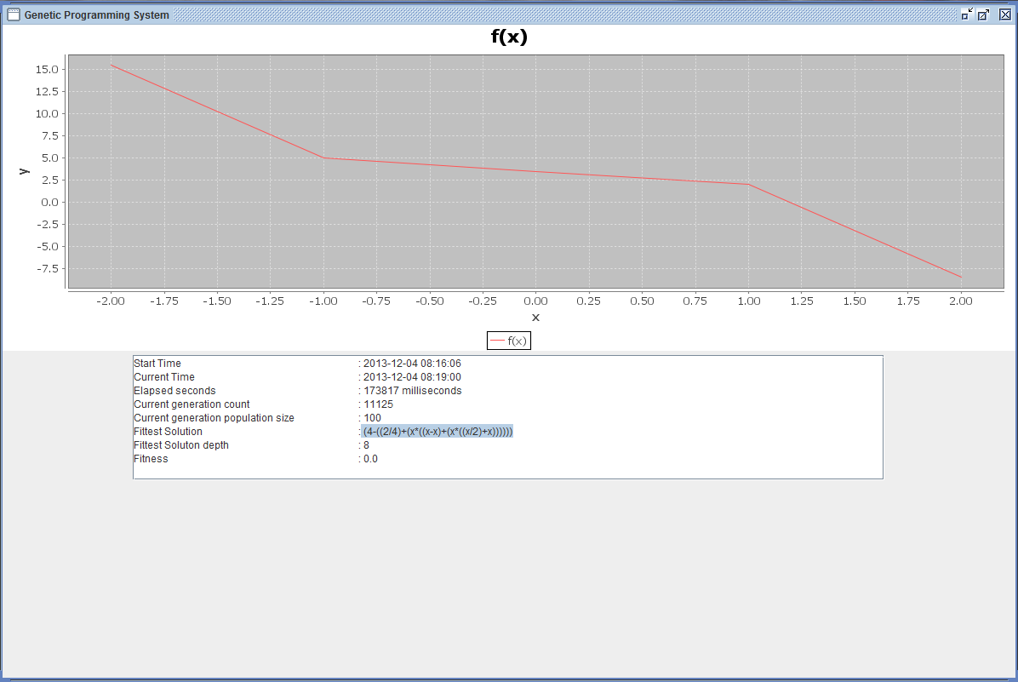
Demonstration
Program Dashboard (using optional requirement)

Slide 16
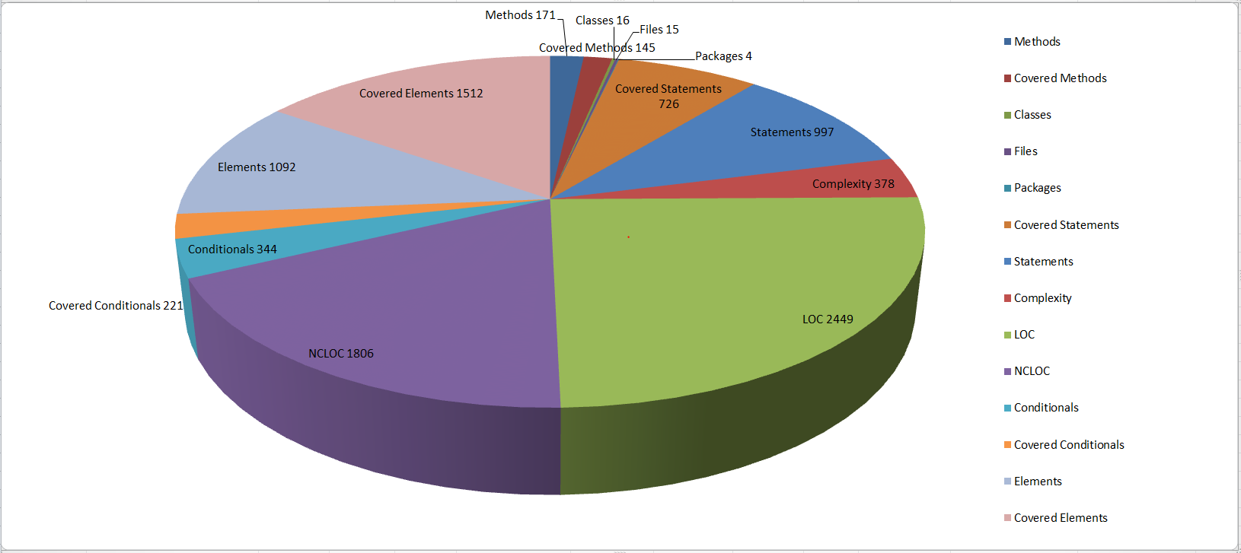
Metrics and Measurement
Size

Slide 17
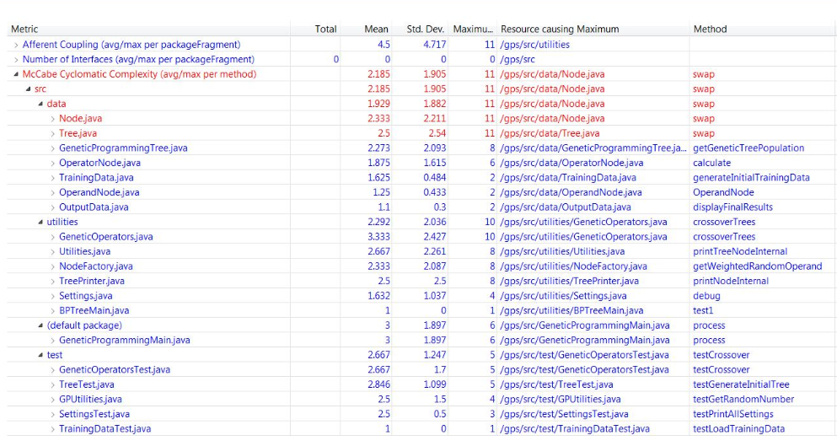
Cyclomatic Complexity
By Method (http://metrics.sourceforge.net/)

Slide 18
Node.swap()
public static void swap(Node nodeOne, Node nodeTwo) throws Exception {
Node parentNodeOne = nodeOne.getParent();
Node parentNodeTwo = nodeTwo.getParent();
if (parentNodeOne != null) {
if (parentNodeOne.getLeftChild() != null && parentNodeOne.getLeftChild() == nodeOne) {
parentNodeOne.setLeftChild(nodeTwo);
} else {
if (parentNodeOne.getRightChild() != null && parentNodeOne.getRightChild() == nodeOne)
parentNodeOne.setRightChild(nodeTwo);
}
}
if (parentNodeTwo != null) {
if (parentNodeTwo.getLeftChild() != null && parentNodeTwo.getLeftChild() == nodeTwo) {
parentNodeTwo.setLeftChild(nodeOne);
} else {
if (parentNodeTwo.getRightChild() != null && parentNodeTwo.getRightChild() == nodeTwo)
parentNodeTwo.setRightChild(nodeTwo);
}
}
}

Slide 19
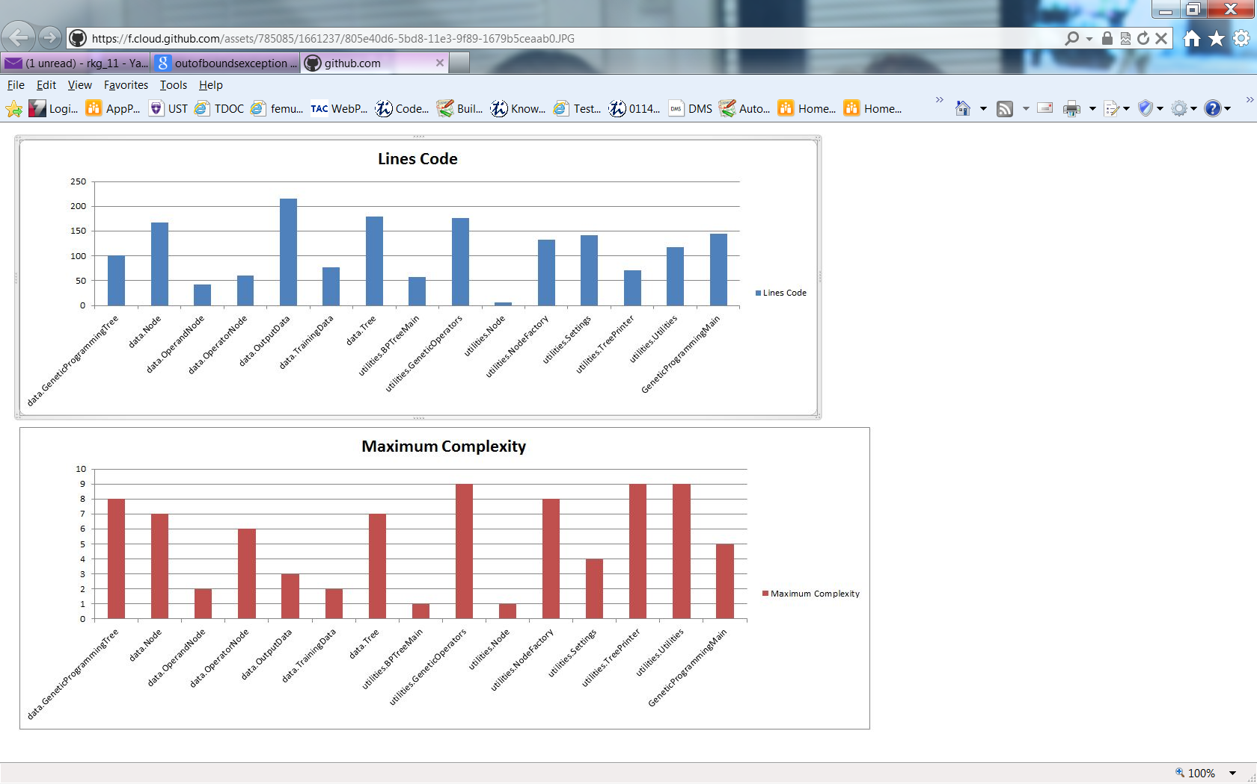
LOC vs. Maximum Complexity
Object/Class Analysis (http://www.scitools.com/)

Slide 20
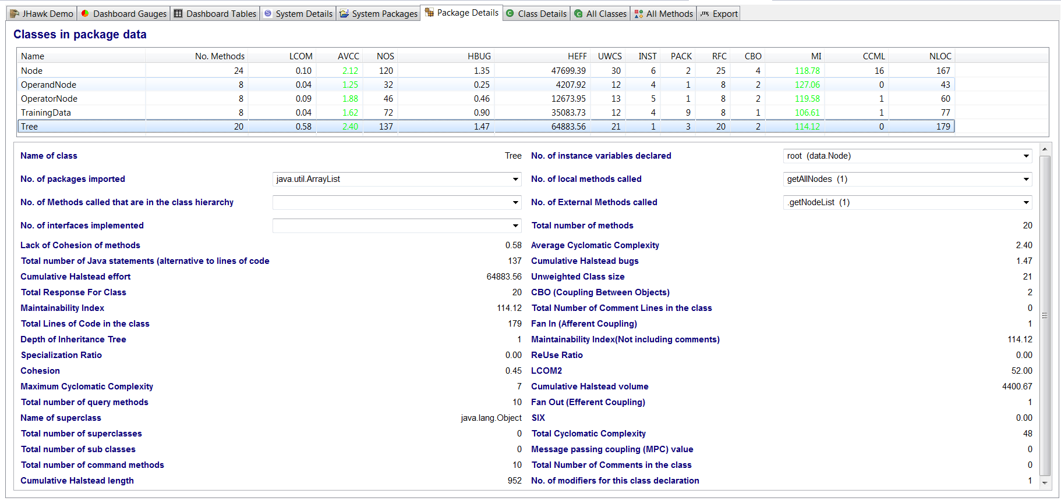
Size Complexity
Halstead Metrics (http://www.virtualmachinery.com/jhawkmetrics.htm)

Slide 21
Outline
Introduction and Assignment #10 (Kholoud)
Project Description (Mohammed)
Requirements (Mohammed)
Analysis and Design (Rajesh)
Demo (Jayesh)
Metrics and Measurement (Jayesh)
Design Decisions (Warsame)
Testing (Warsame)
Lessons Learned (Rajesh)
Conclusion (All)

Slide 22
Design Decisions
GP Tree depth after crossover was capped to a max depth of 8
Initial population of trees has a higher probability of x operand nodes.
Protected divide by 0, results in a 1.
New population is re-generated periodically
Generation population size constant
Java sorting algorithm using highly optimized quicksort

Slide 23
Test Cases
Test-Cases:
These are the core and supporting test cases with their descriptions of what
functionality is being tested.
Test Name | Description
Crossover_Test | This test represents the crossover functionality. Crossover is a means of combining genetic material of two parents (trees) by swapping a part of one parent (tree) with another parent (tree).
Fitness_Tree_Test | This test makes sure a fitness is evaluated for a single. If a tree is invalid due to math issues like divide by zero or a fitness that is too large to be represented by a java double then this test fails.
Sort_Selection_Test | This test will sort a list of Tree objects by fitness and verifies the sort against predefined items matching in ascending order.
Mutation_Test | This test checks to see if a random node in a predefined tree has changed it’s before and after value.
Selection_Test | This test uses a fixture of probabilities such as the selection probability to make sure the number of trees returned meet the predefined criteria.
Divide_By_Zero_Test | This test is testing the tree ‘evaluate’ function for a specific scenario. The test will fail in any ‘divide by zero’ errors and checks to make sure a valid operand is returned.

Slide 24
Test Case Relationships
Relationship to functional requirements:
The test cases are related to our functional core genetic programming concepts. The mutation, crossover and selection functions are unit tested along with the internal methods they rely on.

Slide 25
Defects
Major Defects Encountered during execution:
Index Out Of Bounds Exception
Divide by 0
Stack Over Flow errors in computing Tree size()

Slide 26
Outline
Introduction and Assignment #10 (Kholoud)
Project Description (Mohammed)
Requirements (Mohammed)
Analysis and Design (Rajesh)
Demo (Jayesh)
Metrics and Measurement (Jayesh)
Design Decisions (Warsame)
Testing (Warsame)
Lessons Learned (Rajesh)
Conclusion (Kholoud)

Slide 27
Lessons Learned
Time management
Use case coverage estimations are inadequate
Bug fix estimations can go wrong
Balanced participation among team members
A documented process does not guarantee the process will be followed

Slide 28
Summary
The current GP System implements the software development phases and techniques
The GP System is designed and developed using object-oriented approach
The system provides excellent tractability between all activities in its documents
This system is flexible enough to accommodate changing user requirements

Slide 29
References
How the referenced materials are used in the report
For developing the GP System:
http://www.genetic-programming.com/gpquadraticexample.html
http://www.geneticprogramming.com/Tutorial/
http://geneticprogramming.us/Selection.html
http://docs.oracle.com/javase/tutorial/collections/algorithms/#sorting5.http://books.google.com/books?id=Bhtxo60BV0EC&pg=PA82&lpg=PA82&dq=The+protected+division+function+%25+returns+a+value+of+1+when+division+by+0+is+attempted+genetic+programming&source=bl&ots=9oiRjwg-MN&sig=y5LB1tRPjWwtorVGVgg6Gdi9c1Q&hl=en&sa=X&ei=WiiKUo7zJe3lsASf8YHYCA&ved=0CDYQ6AEwAQ#v=onepage&q=The%20protected%20division%20function%20%25%20returns%20a%20value%20of%201%20when%20division%20by%200%20is%20attempted%20genetic%20programming&f= false
http://www.amazon.com/Genetic-Programming-Introduction-Artificial-Intelligence/dp/155860510X/ref=sr_1_3?s=books&ie=UTF8&qid=1385953621&sr=1-3&keywords=Genetic+Programming
For testing the results of the program:
http://rechneronline.de/function-graphs/
http://www.wolframalpha.com/widgets/view.jsp?id=aeecc5a9c646444f00978ed43e747a96
http://www.wolframalpha.com/widgets/view.jsp?id=97ffcbd95363387c7e371563057eb02f

Slide 30
Conclusion
Questions?

